Slide 1
Network-based Analysis of Genome-wide Association Study (GWAS) Data
Peng Wei
Division of Biostatistics
University of Texas School of Public Health
Email: Peng.Wei@uth.tmc.edu
SRCOS Summer Research Conference 2011
McCormick, SC

Slide 2
Outline
Background and Introduction
GWAS
Biological networks
Statistical Methods
Gene-based association test
Markov random field-based mixture model
Diffusion kernel-based mixture model
Numerical Results
Conclusion and Discussion

Slide 3
Background: GWAS
Manolio TA. N Engl J Med 2010; 363: 166-176.

Slide 4
Background: GWAS
SNP-by-SNP Analysis
Top hits may not have functional implications
Millions of dependent tests due to linkage disequilibrium (LD) among SNPs – low power
GWAS pathway enrichment analysis:
Uses prior biological knowledge on gene functions and is aimed at combining SNPs with moderate signals
e.g., to test if SNPs in the cell proliferation pathway show difference between cases and controls
However, genes within a pathway are treated exchangeably – interactions among genes ignored
Not every gene in a significant pathway is associated with the disease – identifying disease-predisposing genes remains a challenge

Slide 5
Background: Biological Networks
Metabolic space
Metabolite 1
Metabolite 2
Protein space
Protein 2
Complex 3-4
Protein 4
Protein 1
Protein 3
Gene 2
Gene 1
Gene 3
Gene 4
Adapted from Brazhnik P et al. Trends Biotechnol. (2002)
Gene space

Slide 6
Background: Gene Networks
HPRD (Human Protein Reference Database; Protein-Protein Interactions)
-- yeast two-hybrid experiments + hand-curated, literature-based interactions
-- 8776 genes, 35820 interactions
KEGG (Kyoto Encyclopedia of Genes and Genomes)
-- Extracted from KEGG gene-regulatory pathway database
-- 1668 genes, 8011 interactions

Slide 7
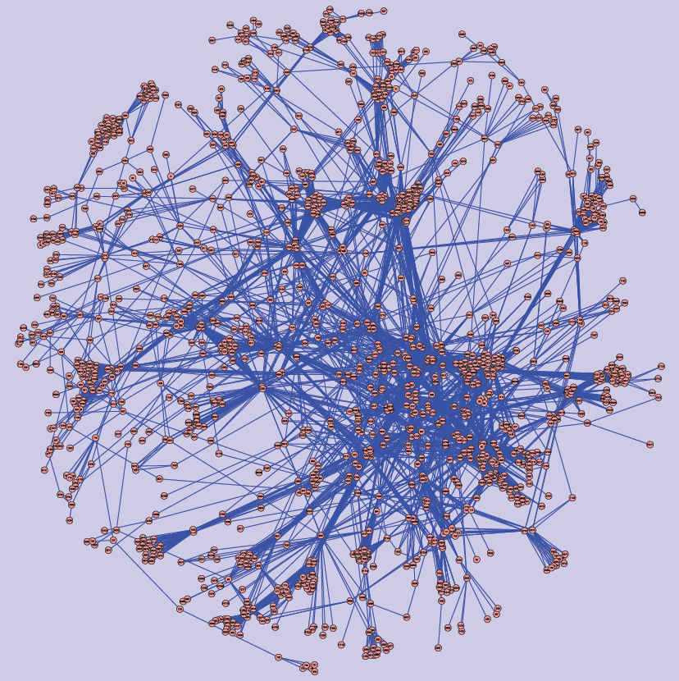
KEGG network
(1668 genes;
8011 interactions)

Slide 8
Introduction: Network-based methods
Markov random field (MRF)-based mixture models have been proposed for incorporating gene networks into statistical analysis of genomic and genetic data: neighboring genes on a network tend to be co-associated with the outcome
Gene expression data: Wei and Li, Bioinformatics 2007;
Wei and Pan, Bioinformatics 2008, JRSS-C 2010)
GWAS data: Chen et al, PLoS Genetics 2011

Slide 9
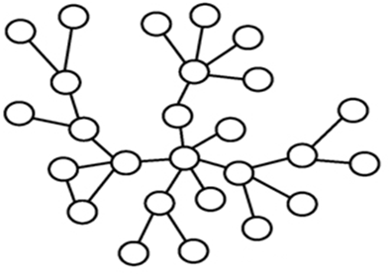
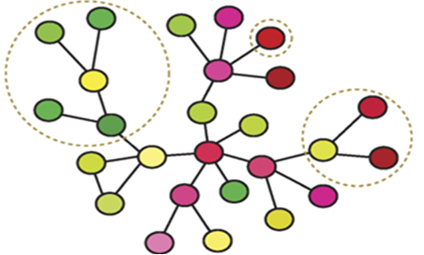
Methods: Network-based GWAS Analysis
SNP data
Gene-level summary
Questions to be addressed here:
Does the choice of network matter?
Does looking beyond direct neighbors help?

Slide 10
Data: Crohn’s Disease (CD)
A type of inflammatory bowel disease
An auto-immune disease
High heritability– strong genetic link
Large number of confirmed loci (SNPs/genes)
--105 genes at 71 loci based on meta-analysis of six GWAS (Franke et al. Nature Genetics 2010)

Slide 11
Crohn’s Disease GWAS Data
Wellcome Trust Case Control Consortium (WTCCC)
2,000 CD cases, 3,000 controls and a total of 500,568 SNPs
1748 CD cases and 2938 controls and 469,612 SNPs
Data Quality Control

Slide 12
Methods: From SNP Level to Gene Level
SNP to gene mapping– the “20Kb Rule”
Gene-level summary statistics
Principle component analysis (PCA) followed by logistic regression
20Kb
20Kb
5’-UTR
Gene
3’-UTR
SNPs
eigen SNPs
logit Pr(D_{j}=1) = β₀ + β₁x_{1j} + … + β_{p}x_{pj}
H₀: β₁ = β₂ = … = β_{p} = 0

Slide 13
Methods: From SNP Level to Gene Level
Gene-level summary statistics
Alternative approach: Logistic Kernel- machine-based test (Wu et al AJHG 2010)
z-score transformation of gene-level p-values:
z_{i} = Φ⁻¹(1- P_{i}), where Φ is the cdf of N(0, 1)
logit Pr(D_{j}=1) = β₀ + h(z_{1j} ,…,z_{pj} )
H₀: h(z)=0

Slide 14
Methods: Standard Mixture Model (SMM):
Treats all genes equally a priori
π₀ = Pr(T_{i}=0) 1- π₀ = π₁ = Pr(T_{i}=1)
f₀ ~ ϕ(µ₀, σ₀²) f₁ ~ ϕ(µ₁, σ₁²)
T_{i}: latent state of gene i
Bayesian framework: p(T, θ|z)
p(z |T, θ) p(T) p(θ)
θ=(µ₀, µ₁, σ₀², σ₁²)
Statistical Inference: : p(T_{i} =1|z)

Slide 15
Methods: MRF-based mixture model (MRF-MM)
The latent state vector $T=(T_{1},…,T_{G})′$ is modeled as a MRF via the following auto-logistic model
$\text{logit}\text{ (}\text{P}\text{(}T_{i}|T_{(−i)}\text{)) = }\text{logit} \text{P}\text{(}T_{i}|T_{∂i}\text{)}$ $\text{= }γ+ β\left[\sum_{j∈∂i}{I\left(T_{j}=1\right)−}\sum_{j∈∂i}{I\left(T_{j}=0\right)}\right]/m_{i}$,
where $γ$ is a real number, $β$>0.
Bayesian framework:
p(T, θ,Φ|z)
p(z |T, θ) p(T|Φ) p(θ) p(Φ)
θ= (µ₀, µ₁, σ₀², σ₁²), Φ= (β, γ)
Statistical Inference: : p(T_{i} =1|z)

Slide 16
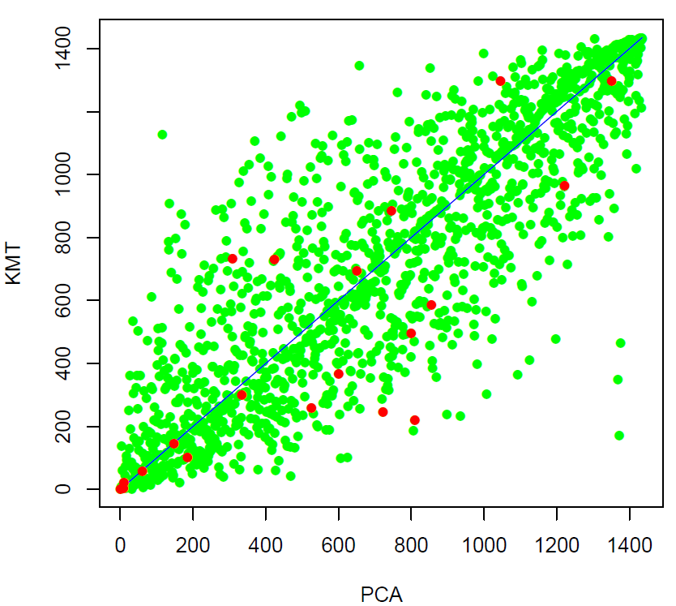
Comparison of gene-based tests (1435 genes on the KEGG network; red dots are 21 confirmed CD genes)

Slide 17
SMM (Kernel-machine test z-scores)

Slide 19
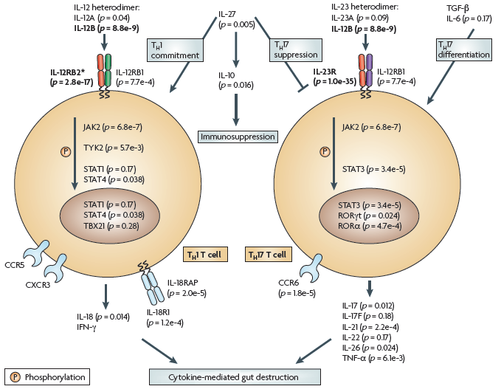
CD Pathway
Wang K et al., Nat Rev Genet. 2010

Slide 20
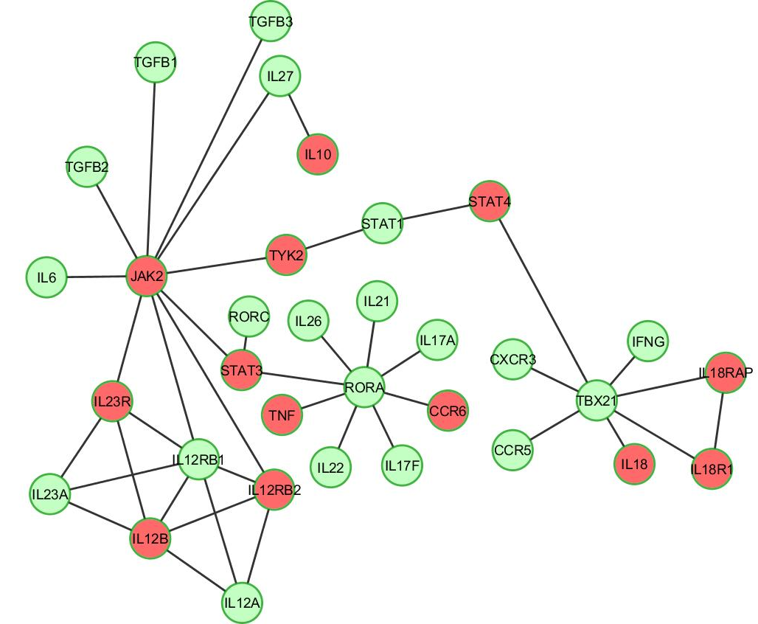
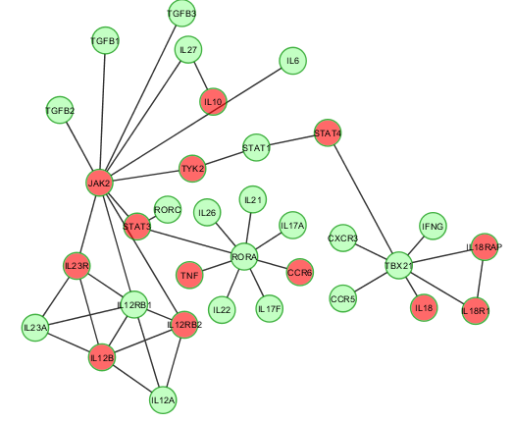

Slide 21
Diffusion Kernel (DFK)
Diffusion Kernel (Kondor and Lafferty 2002): Similarity distance between any two nodes in the network.
$K=exp\left(τL\right)=\sum_{m=0}^{∞}{\frac{τ^{m}}{m!}L^{m},}$
1 if gene i ~ j
L_{ij} =
-d_{i} if i = j
0 otherwise
τ >0 : decay factor
L: graph Laplacian
d_{i} : # of direct neighbors of gene i
exp(L): matrix exponential of L

Slide 22
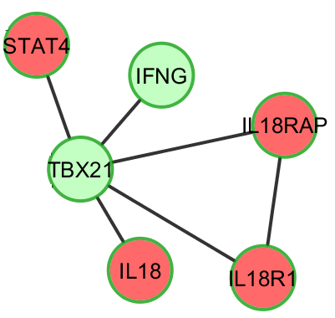
Diffusion Kernel (DFK) – beyond direct neighbors
 | STAT4 | IL18 | IL18R1 | IL18RAP | TBX21 | IFNG
STAT4 | - | 0 | 0 | 0 | 1 | 0
IL18 | 0.05 | - | 0 | 0 | 1 | 0
IL18R1 | 0.05 | 0.05 | - | 1 | 1 | 0
IL18RAP | 0.05 | 0.05 | 0.24 | - | 1 | 0
TBX21 | 0.16 | 0.16 | 0.16 | 0.16 | - | 1
IFNG | 0.05 | 0.05 | 0.05 | 0.05 | 0.16 | -

Slide 23
Diffusion Kernel-based mixture model (DFK-MM)
MRF: First-order (direct) interactions
DFK: Interactions of all orders

Slide 27
Conclusion and Discussion
Does the choice of network matter?
Yes, the KEGG gene regulatory seemed to be more informative than the HPRD protein-protein-interaction network
Does looking beyond direct neighbors help?
Yes, the DFK-based model was found to be more powerful than the MRF-based model based on application to the CD GWAS data as well as simulated data (results not shown)
In summary, network-based models were demonstrated to be useful for gene-based GWAS analysis
Network information mainly boosted the power for discovering genes with moderate association signals

Slide 28
Potential problems and future work
Existing gene networks are incomplete
– we use network information as informative prior
Types of networks matter: protein-protein interaction, gene regulatory, co-expression networks, etc – incorporate multiple networks simultaneously
Joint effect vs Marginal effect - regression framework

Slide 29
Acknowledgement
Joint work with Ying Wang (graduate student @ UT School of Public Health)
Support from UT SPH PRIME award

